Slide 1
CI/CD Test-Describer
software maintenance and evolution

Slide 2
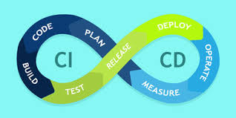
CI/CD - Continuous integration/continuous delivery
It is a practice that focuses on using automation to make deploying, testing and integrating different components of a program autonomous and always run in the same environment

Slide 3
CI/CD Advantages
Reduce costs: Using automation in the CI/CD pipeline helps reduce the number of errors that can take place in the many repetitive steps of CI and CD.
Smaller code changes: One technical advantage of CI and CD is that it allows you to integrate small pieces of code at one time. This helps developers to recognize a problem before too much work is completed afterward.
Faster release rate: Failures are detected faster and as such, can be repaired faster, leading to increasing release rates.
Fault isolations: Designing your system with CI/CD ensures that fault isolations are faster to detect and easier to implement.
More test reliability: Using CI/CD, test reliability improves due to the bite-site and specific changes introduced to the system, allowing for more accurate positive and negative tests to be conducted.

Slide 4
CI/CD pipeline
Phase 1: Commit
When developers complete a change, they commit the change to the repository.
Phase 2: Build
Source code from the repository is integrated into a build.
Phase 3: Automate tests
Automated tests are run against the build. Test automation is an essential element of any CI/CD pipeline.
Phase 4: Deploy
The built version is delivered to production.

Slide 5
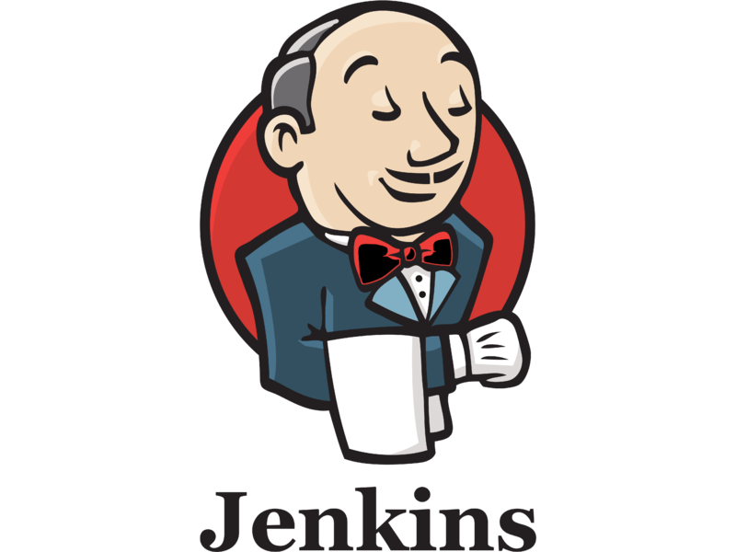

CI/CD Test-Describer
Test-Describer

Slide 6
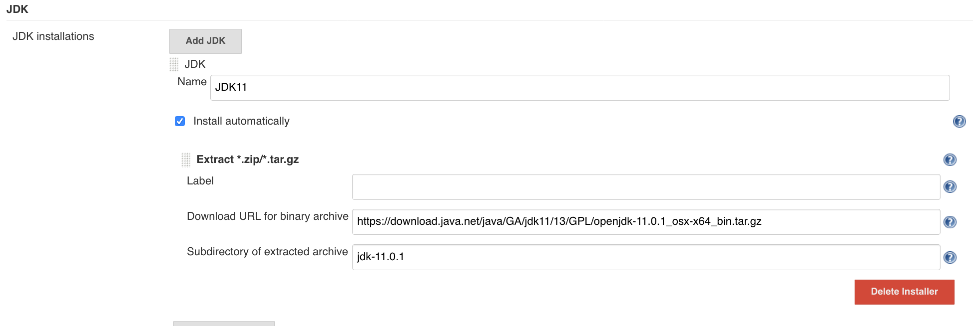
Jenkins - Setup
Set up Jenkins in localhost
Install and Run Docker
Install a JDK in Jenkins in Global Tool Configuration

Slide 7
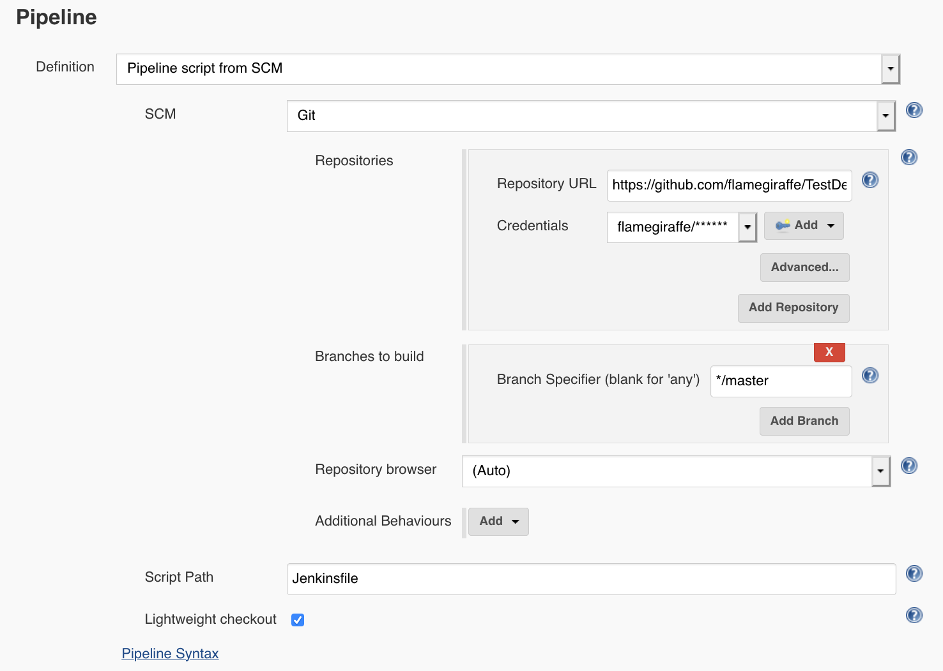
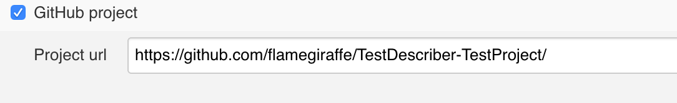
Jenkins - Pipeline
Create new Jenkins Pipeline
Connect to GitHub project
Define path to Jenkinsfile

Slide 8
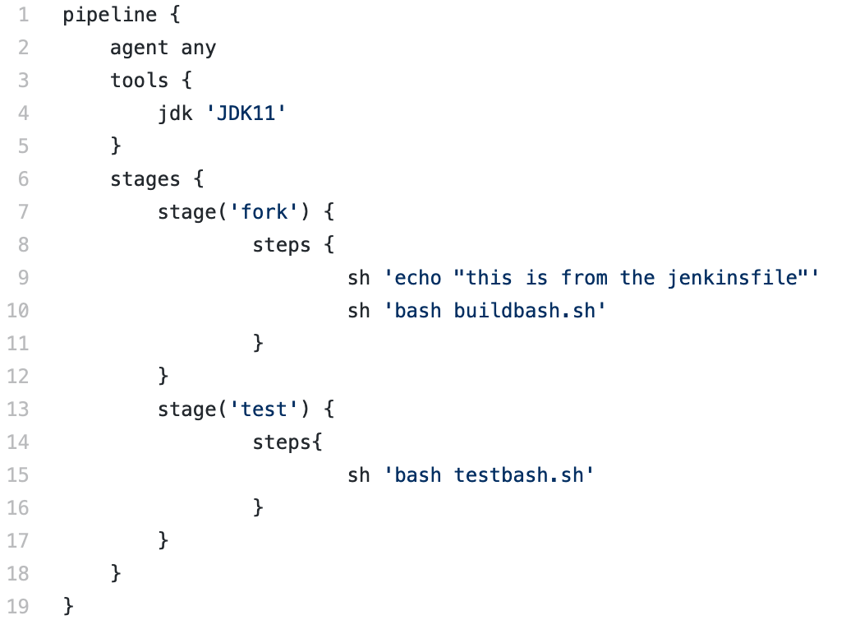
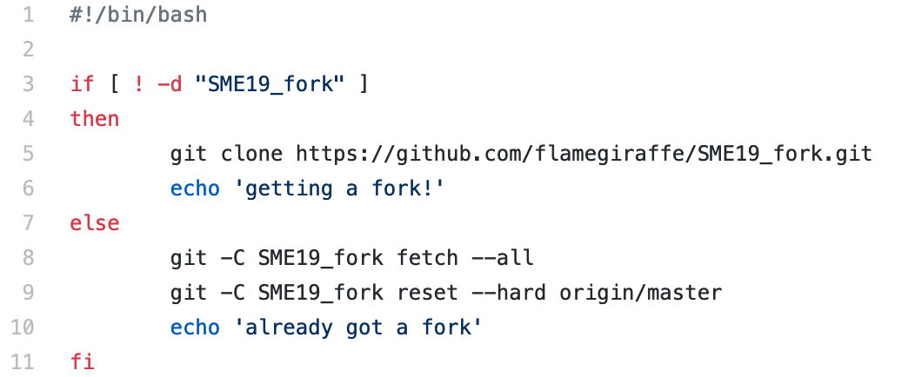
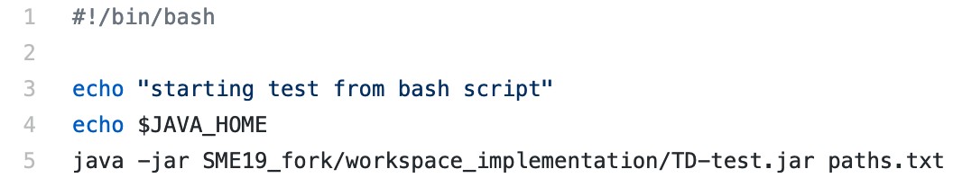
Jenkins - Jenkinsfile
Create Jenkinsfile
Reference JDK installed earlier as a required tool
Clone TestDescriber repository, or update if it is already downloaded
Run the JAR from the downloaded repository with a text file as input that contains all paths

Slide 9
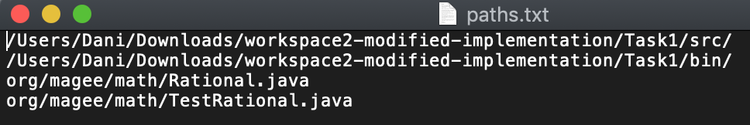
Jenkins - Paths text file
First line: absolute path to src folder
Second line: absolute path to bin folder
Every pair of lines thereafter: additional paths to the class being tested, and the test class.

Slide 10
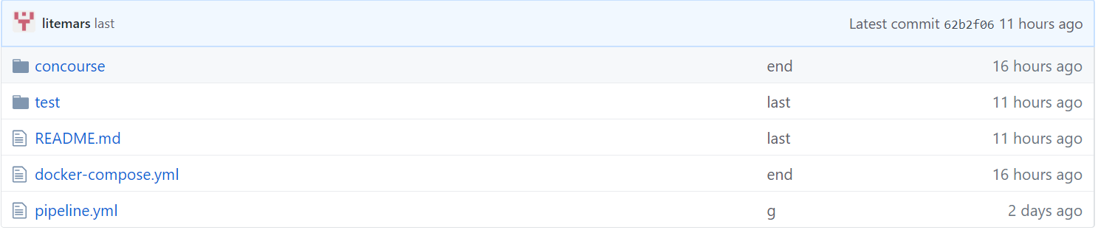
Concourse
Define the pipeline
Define the tasks
Define for each task what the system should do
you can get an example from my Github repository

Slide 11
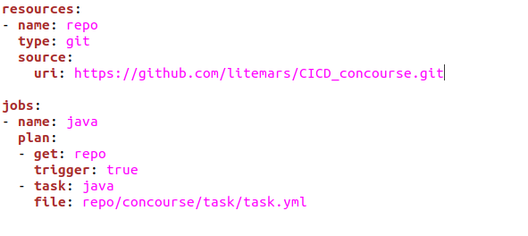
Define the pipeline
Where the source is
How many jobs there are

Slide 12
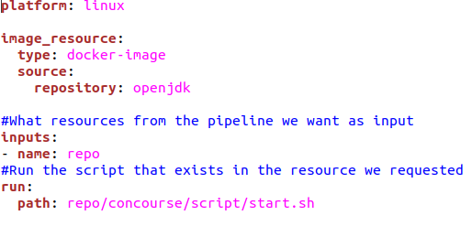
Define the task
Which Docker image is
script for the task

Slide 13
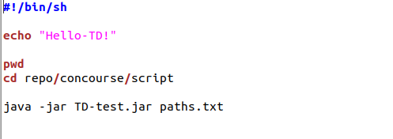
Bash script
You have a bash and you can write whatever you want!

Slide 14
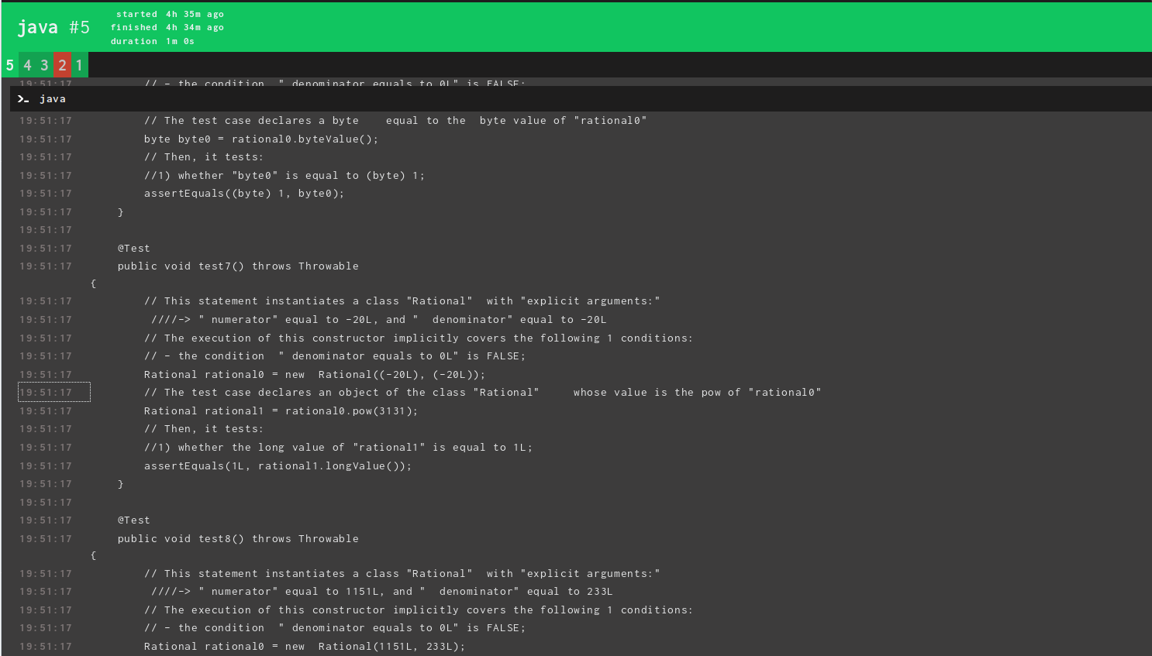
Result
Now, every time that your repository is triggered, concourse will do an automatically work for you

Slide 15
Thank you!
Any questions?

